Slide 1
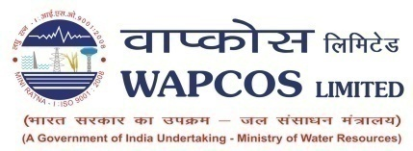
Role of Consultants in Developing Sustainable Projects
Pooja Kapoor
Head (Business Development)

Slide 2
Sustainable Project
"Development that meets the needs of the present without compromising the ability of future generations to meet their own needs.”
Problem
Solution
Project
Need a Consultant
Design
&
Supervise
Convert the Project into a
SUSTAINABLE PROJECT

Slide 3
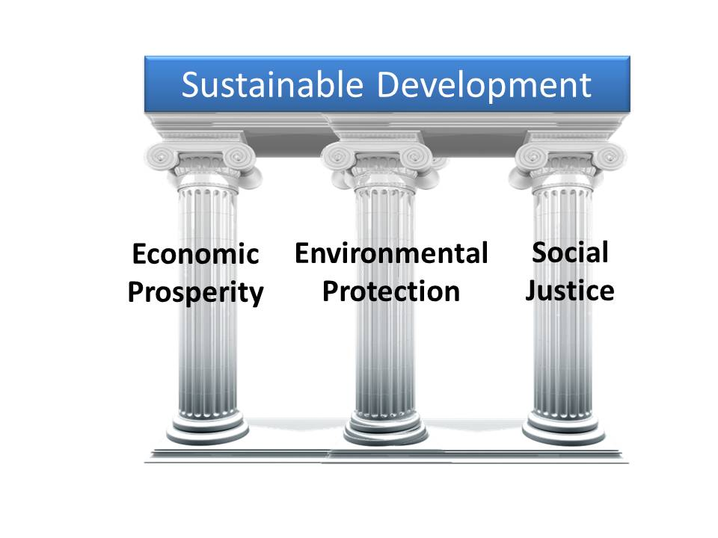
SUSTAINIBILITY
PILLARS OF SUSTAINIBILITY

Slide 4
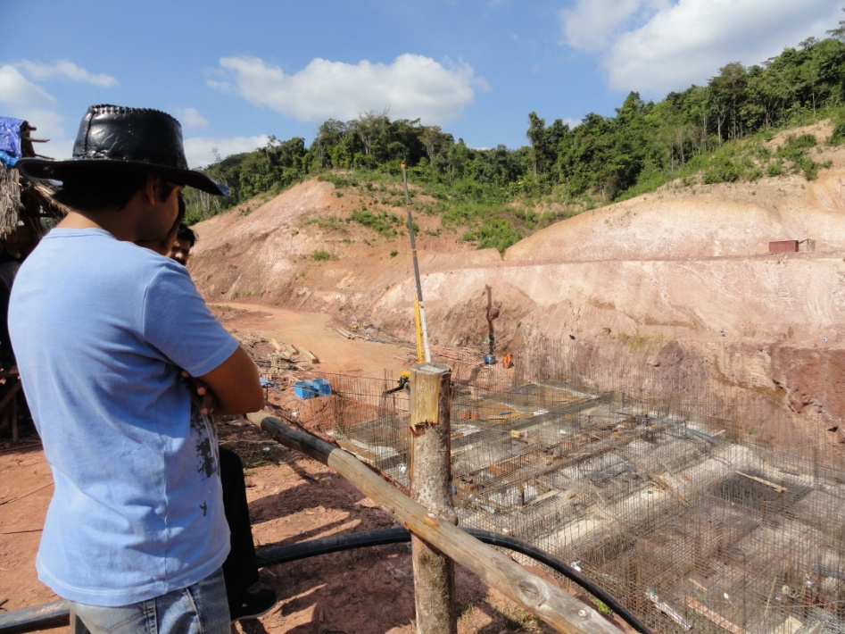
A Technical Consultant is like a Doctor
As a specialized doctor is needed
To diagnose the disease
To provide the right medication in the right amount
To cure a patient
An expert technical consultant is needed
To understand the project
To understand client specific requirements
Suggest solutions

Slide 5
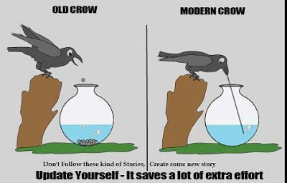
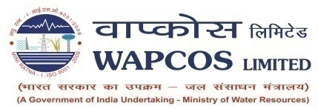
Why an Expert Consultant is needed ?
To Work Smart
not Hard
To achieve the target and project objectives
To achieve the right balance between cost benefits and risk

Slide 6
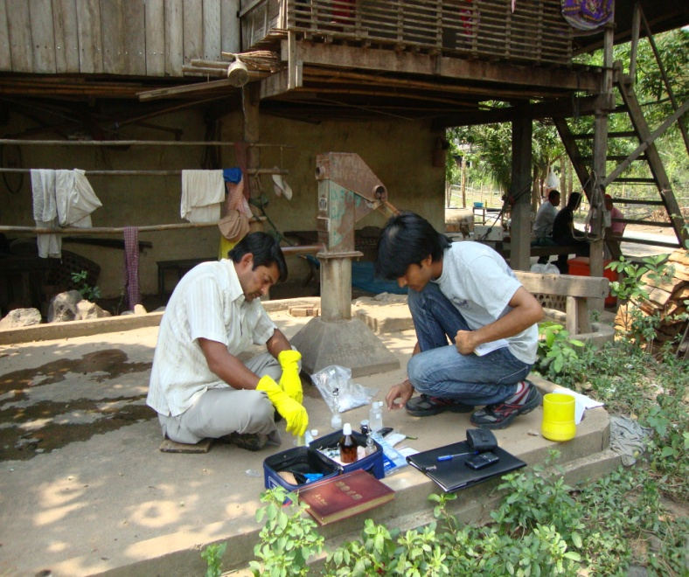
ROLE OF WAPCOS
Policy Studies / Development of Master Plans
Pre-investment Studies / Financial Engineering
Evaluate Viability and Risks
Technology Promotion
Create opportunities for Indian Exports
(Goods/Projects)
Catalyst for timely and quality delivery of the
Project
Confidence of borrower in Project Sustainability
Transfer of Technology and Technical Expertise
Can be appointed by
Funding Agency
Lender’s Engineer
Borrowing Govt.
Owner’s Engineer
Recommended by Funding Agency to develop the Project from Concept to Commissioning and appointed by borrowing Govt.
Project Developer
Project Developer

Slide 7
Project Identification
Previous Projects
Resident Mission
Borrowers Proposals
Project Identification
General Layout
Cost Estimates
Techno-Economic Viability
Project Implementation
Schedule
Phasing of Expenditure
FR/ER
Consultant Vetting
Other Reports

Slide 8
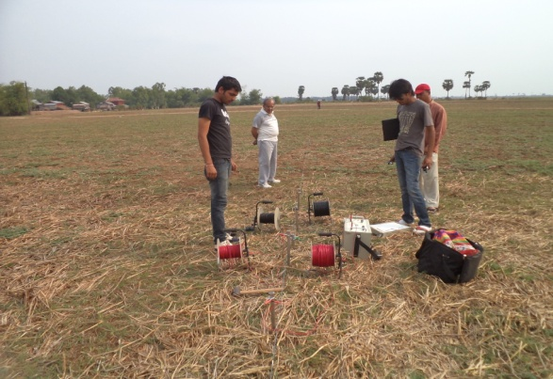
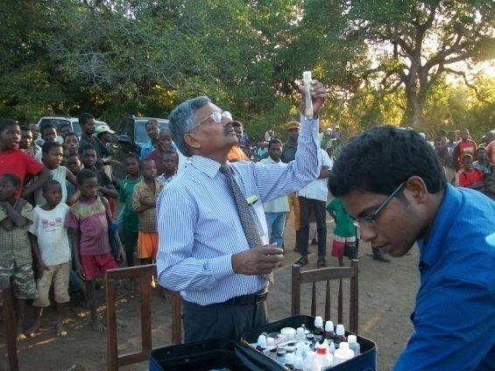
1. Lender’s Engineer
Pre-Shipment Testing/Inspection
Equipment testing & Certification
Factory Acceptance Tests
Review & Checking of
Feasibility Report
Technical viability
Financial Analysis
Evaluation of DPR
Design of Project Components
Socio-economic Impact Assessment
Construction Programme & Methodology
Financial Analysis
O&M Plan
Project Management Consultancy
Construction Supervision
Quality Control
Measurement of Works
Post Evaluation
Consultants are required right from the stage of identification of project/supply
requirements to successful building/construction or delivery of equipment/material

Slide 9
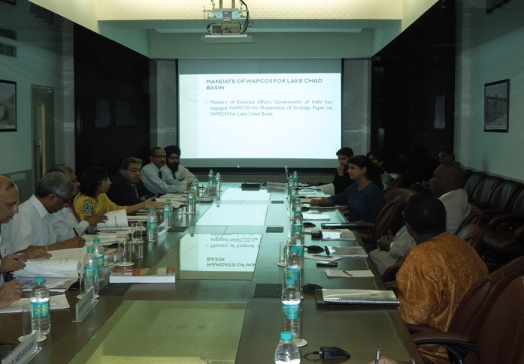
2. Owner’s Engineer
Preparation of Feasibility Report
Technical viability
Financial Analysis
Tender Engineering
Project Management Consultancy
Construction Supervision
Quality Control
Measurement of Works
Testing & Commissioning
Post Evaluation
Survey and Investigation
Preparation of DPR
Detailed Design of Project Components
Environmental Impact Assessment
Financial Analysis (IRR, BCR)
O&M Plan
Capacity Building
Training
Transfer of Technology
Pre-Shipment Testing/Inspection
Equipment testing & Certification
Factory Acceptance Tests
Consultants are required right from the stage of identification of project / supply
requirements to successful building/construction or delivery of equipment/material

Slide 10
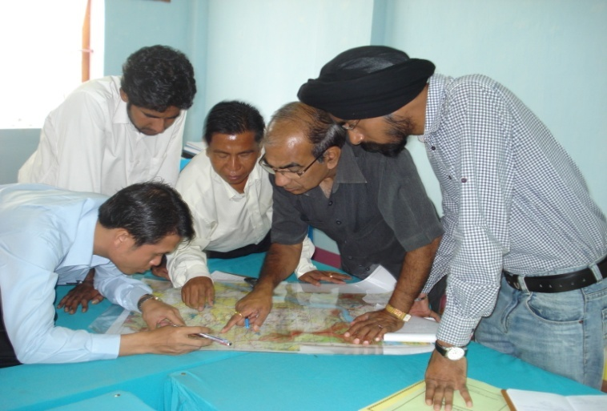
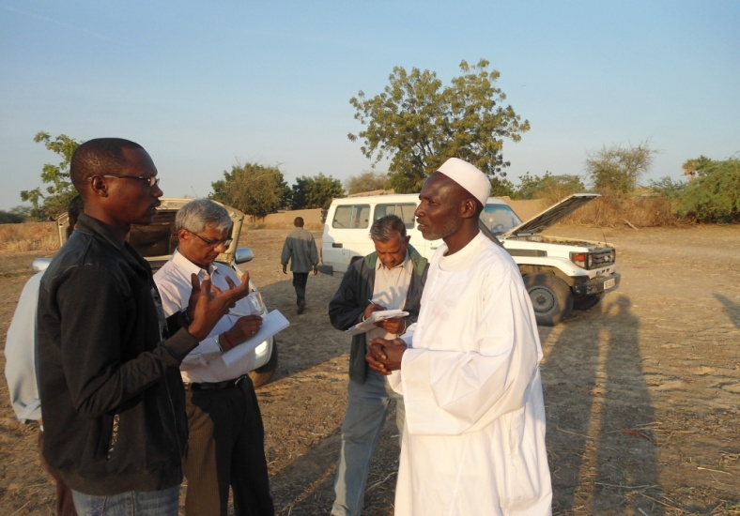
3. Project Developer
Feasibility Studies
Survey & Investigations
Detailed Project Report
Pre-Contract Services
Tendering
Bid Evaluation
Award of Works
Implementation Schedule
Preparation of Construction Drawings
Pre-Shipment Testing/Inspection
Construction Supervision
Contract Management
Quality Control
Training
Operations & Maintenance
Consultants are required right from the stage of identification of project / supply
requirements to successful building/construction or delivery of equipment/material

Slide 11
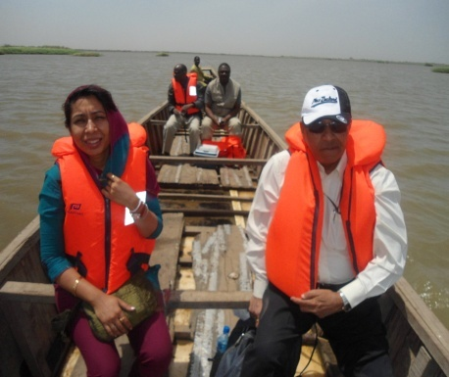
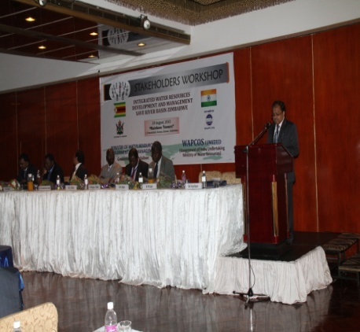
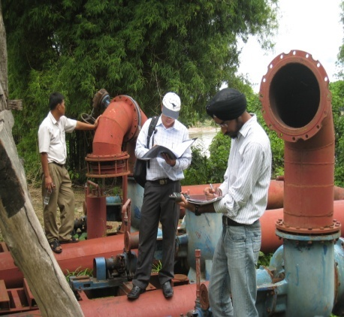
Benefits of Consultants
Better Quality of Work
Catalyst or Facilitator in guiding multi-step process
Minimize Operational Mechanism
Avoid conflict of Interest
Develop Vision to create a more inclusive growth
Fill a short-term gap in the staffing structure
Overall Guidance throughout the project
Completion of the Project in cost effective manner

Slide 12
Making the Owner Self Sustainable
Training and transfer of technology
Participation in Project Execution and Management
Organizing workshops and study tours
Formation of Water User’s Association
Preparation of Operation and Management Plans
Training for Running & Maintenance

Slide 13
Thank You

Slide 14
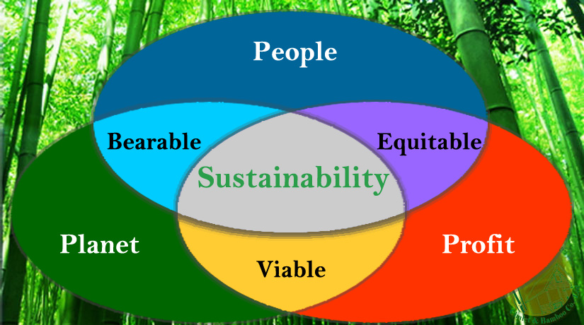
SUSTAINIBILITY PARADIGM

